Slide 1
FEEDBACK CONTROL SYSTEM
LAB # 1
Prepared By :
M. Hammad Saleem
NED University of Engineering & Technology

Slide 2

Part III: Transfer Function
Objective:
The objective of this session is:
Partial Fraction Expansion,
Transfer Function Representation
Pole-Zero location of a Transfer Function

Slide 3
1.1. Obtain the partial fractions of the function F(s) = (s + 1)/ (s² + s + 1).
close all;
clear all;
clc;
b=[1 1];
a=[1 1 1];
[r,p,k]=residue(b,a) %It finds the residues, pole and direct terms of a partial fraction expansion of the function F(S).
The result of the command is;
r =
0.5000 - 0.2887i
0.5000 + 0.2887i
p =
-0.5000 + 0.8660i
-0.5000 - 0.8660i
k =
[]

Slide 4
% to verify the outputs obtained above, the transfer function can be regenerated by using the obtained values of r,p,k.
[b1,a1]=residue(r,p,k)
The result of the command is;
b1 =
1 1
a1 =
1.0000 1.0000 1.0000

Slide 5
1.2. Define the following transfer function G(S) in MATLAB.
G(s) = s (s + 1) (s + 2) / s (s + 3) (s² + 4s + 8).
close all;
clear all;
clc;
num=[5 15 10];
den=[1 7 20 24 0];
sys=tf(num,den) %generates the transfer function with the given numerator num and denominator den.
The result of the command is;
Transfer function:
5 s^2 + 15 s + 10
---------------------------
S^4 + 7 s^3 + 20 s^2 + 24 s

Slide 6
1.3. Find the location of the zeros, poles and plot the pole-zero map of the system, whose transfer function given by;
F(s) = (2s² + 8s + 6) / (s4 + 6s³ + 12s² + 24s)
close all;
clear all;
clc;
num=[0 0 2 8 6];
den=[1 6 12 24 0];
[z,p,k]=tf2zp(num,den) % generates the poles, zeros and gain
The result of the command is;
z =
-3
-1
p =
0
-4.5198
-0.7401 + 2.1822i
-0.7401 - 2.1822i
k =
2
The result specifies that the zeros are at s=-3 and -1, the poles are at
s=0, -4.5198, -0.7401 + 2.1822i and -0.7401 - 2.1822i and the gain is k=2.

Slide 7
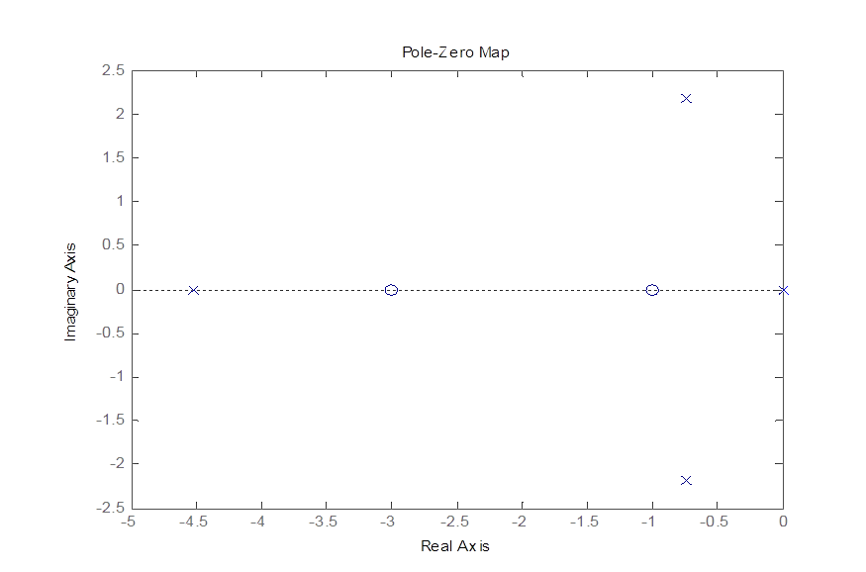
Pole-zero map for this function can be obtained by using the following command.
pzmap(num,den)

Slide 8
1.4) Verify the results obtained for example 1.3 by obtaining the transfer function from the calculated values of zeros, poles and gain.
close all;
clear all;
clc;
z=[-3; -1];
p=[0; -4.5198; -0.7401 + 2.1822i; -0.7401 - 2.1822i];
k=2;
[n,d]=zp2tf(z,p,k);
printsys(n,d,'s') % prints the transfer function as a ratio of two polynomials in the transform variable 's'.
The result of the command is
num/den =
2 s^2 + 8 s + 6
-------------------------------
s^4 + 6 s^3 + 12 s^2 + 24s

Slide 9
1.5. Find the Laplace transform of the function
f (t) =e^{-t} (1-sin (t))
clear all;
close all;
clc;
syms t %define the function f(t)
ft=exp(-t)*(1-sin(t));
fs=laplace(ft)
The result of the command is;
fs =
1/(s + 1) - 1/((s + 1)^2 + 1)

Slide 10
1.6) Find the inverse Laplace transform of the function
F(s) =1/(s + 4).
clear all;
close all;
clc;
syms s t %construct symbolic objects for Laplace transform variable 's' and time variable 't'.
fs=1/(s+4);
ft=ilaplace(fs)
The result of the command is;
ft =
1/exp(4*t)

